Slide 1
Belal Abzakh
Family
Legacy
Loyalty
Accomplishment
Trust
Excellence
Impact

Slide 2
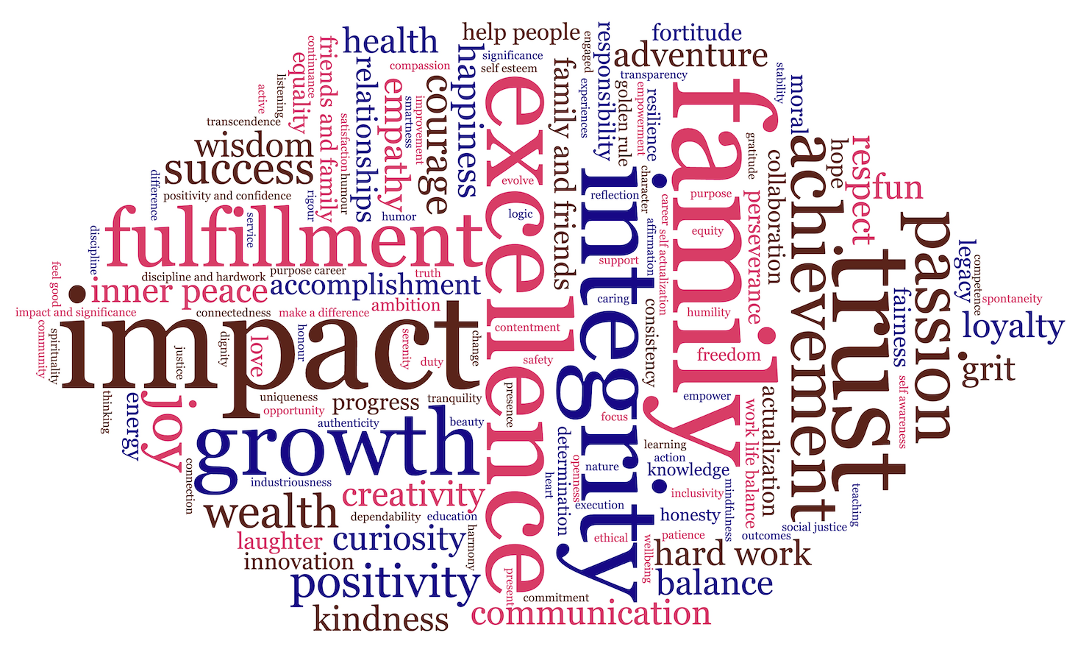

Slide 3
Jaafar Alaydaroos
Fulfillment
Family & Friends
Impact
Purpose/ Career
Mentoring
Integrity & Ethics
Discipline & Hardwork
Wisedom

Slide 5
Blair Ball
Fulfillment
Purpose
Serenity
Impact
Community
Grit
Dependability
Fun

Slide 7
Michael Zhu
Feel good
Improvement
Family
Work life balance
Consistency
Tranquility
Equality
Progress

Slide 9
Pavel Yanshevskiy
Freedom
Wisdom
Work-life balance
Improvement
Equanimity
Knowledge
Self-awareness
Presence

Slide 11
Abhay Vashistha
Happiness
Greatness
Golden rule
Heart
Wellbeing
Passion
Commitment
Listening

Slide 13
Arjun Thummalachetty
Success
Impact + Significance
Family + Friends
Positivity + confidence
Wealth
Honesty
Energy
Stability
Equality

Slide 15
Thomas Spencer
Love
Courage
Trust
Empathy
Curiosity
Loyality
Integrity
Dignity

Slide 17
Vijay Selvaraj
Tranquility
Impact
Work-life balance
Health
Creativity
Curiosity
Consistency
Collaboration
Communication

Slide 19
Nini Perret-Gentil Acedo
Happiness
Family
Balance
Sense of belonging
Respect
Responsibility
Empathy
Trust

Slide 21
Joshua Pennise
Contentment
Accomplishment
Impact
Joy
Competence
Trust
Do what’s right
Fairness

Slide 23
Priya Patil
Health
Impact
Friends & family
Curiosity
Nature
Collaboration
Positivity
Empower
Growth

Slide 25
Owen McAllister
Reflection
Affirmation
Kindness
Friends & Family
More courage
Excellence
Maximise income
Education

Slide 27
Yang Liu
Uniqueness
Make a difference
Opportunity
Creativity
Wealth
Knowledge
Adventure
Courage

Slide 29
Marcela Figueiredo De Oliveira
Fun
Fulfillment
Relationships
Progress
Give your all
Trust
Communication
Do the right thing

Slide 31
Thiago Felippe
Inner Peace
Wellbeing
Evolve/Progress
Family
Golden Rule
Positivity
Integrity
Caring

Slide 33
Veronica Deliza Pereira
Satisfaction
Family & friends
Do the right thing
Humor
Trust
Determination
Commitment
Productivity

Slide 35
John Caridi
Fulfillment
Integrity
Discovery
Courage
Grit
Hardwork
Professionalism
Thinking

Slide 37
Alexandre Chouairi
Success
Make things better
Fulfillment
Achievement
Accomplishment
Respect
Change
Ambition
Responsibility
Growth
Learning

Slide 39
Kevin Chu
Continuance
Duty
Outcomes
Wealth
Health
Difference
Truth
Logic

Slide 41
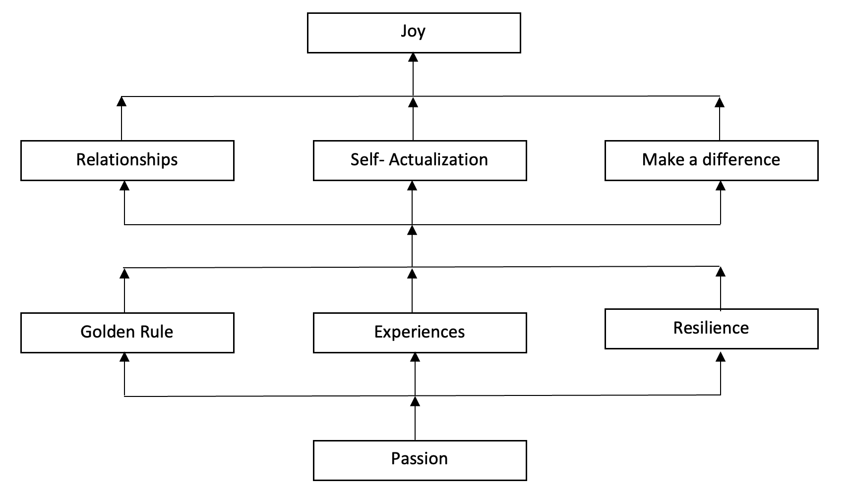
Gaurav Agarwal

Slide 43
Norah Alahmed
Growth
Family and Friends
Wealth
Ethical
Impact
Help People
Excellence
Respect
Hard Work

Slide 45
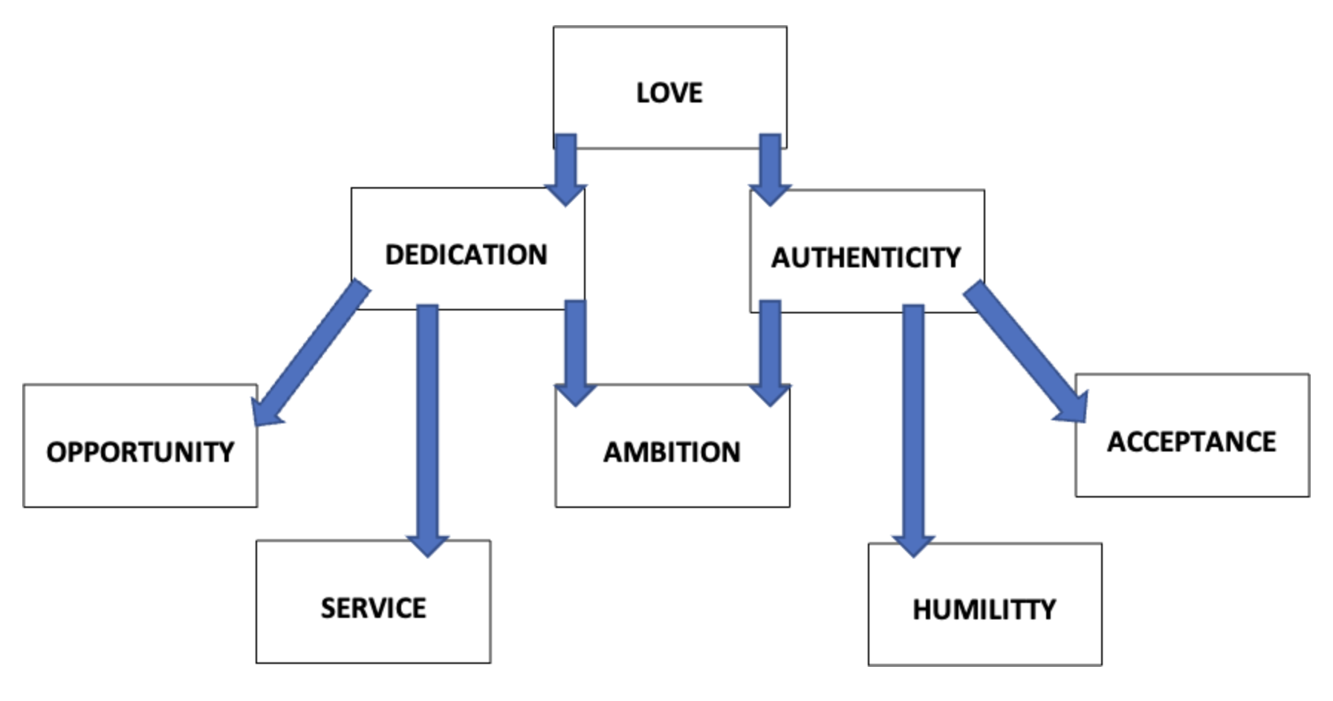
Karim Amer

Slide 47
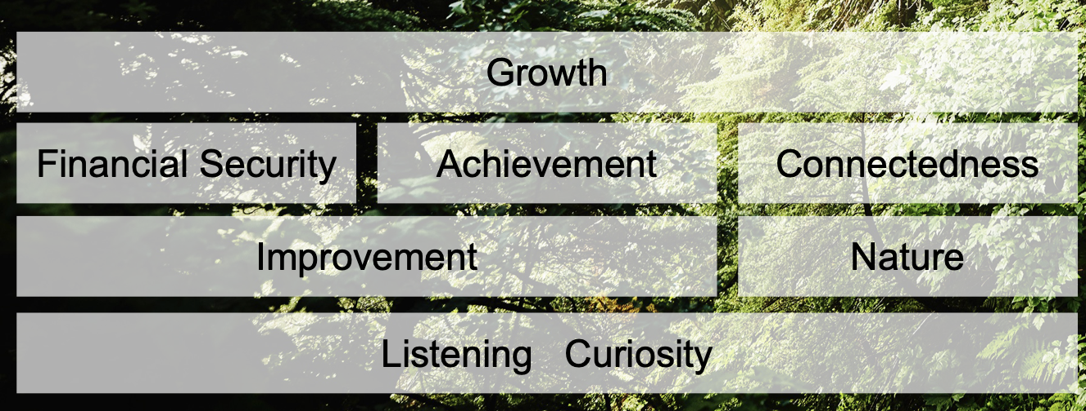
Joey Berry

Slide 49
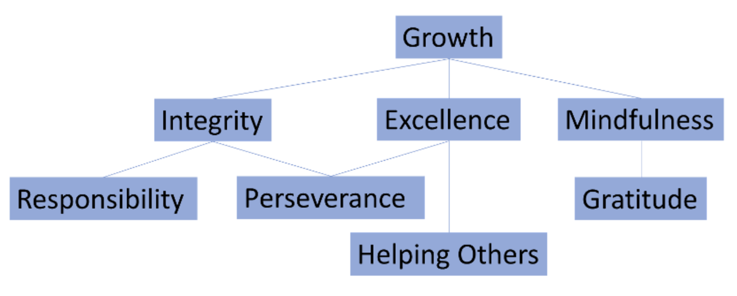
Christian Cantalupo

Slide 51
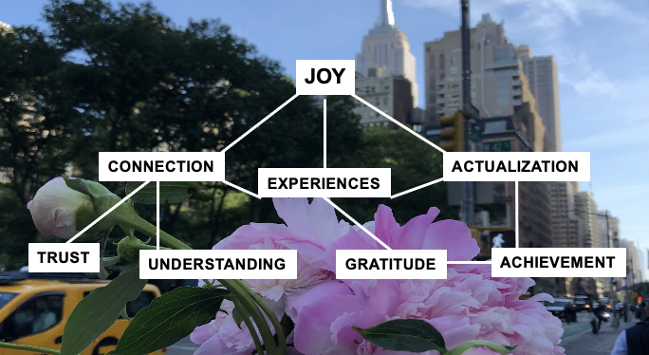
Mary Colpo

Slide 53
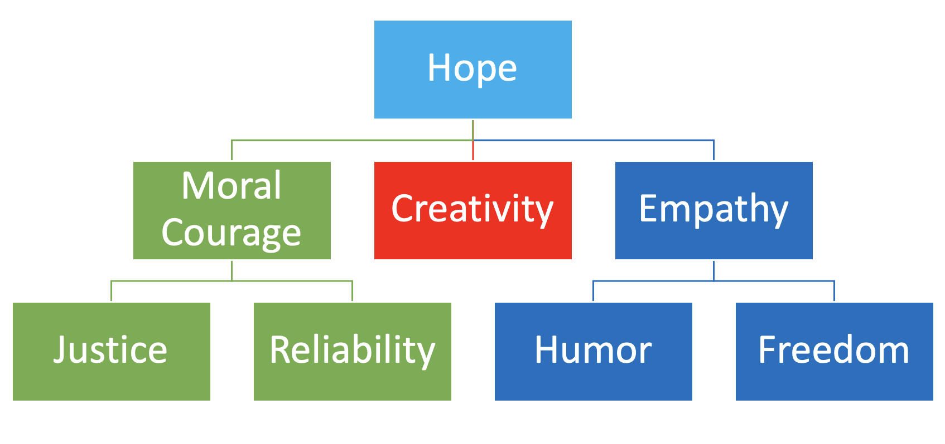
Juan Cortes Acra

Slide 55
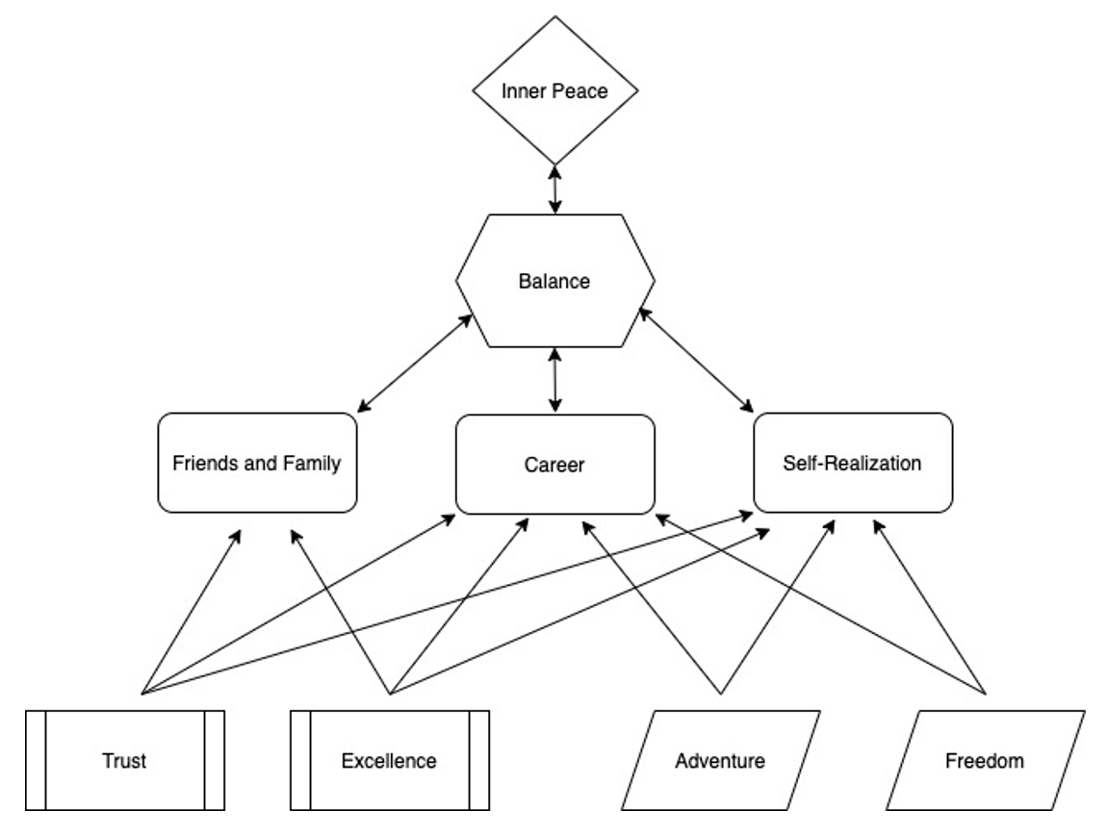
Joseph Dalton

Slide 57
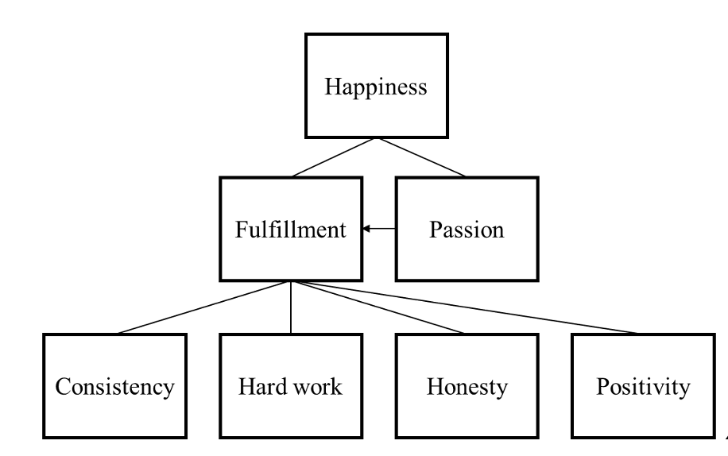
Pablo De Michelis

Slide 59
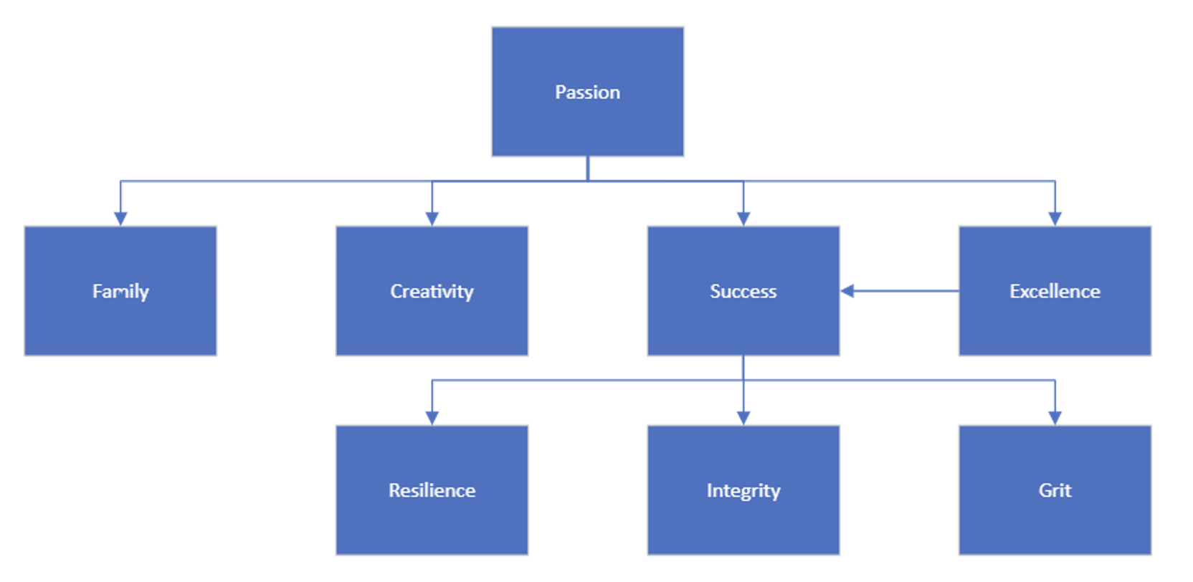
Emily Erickson

Slide 61
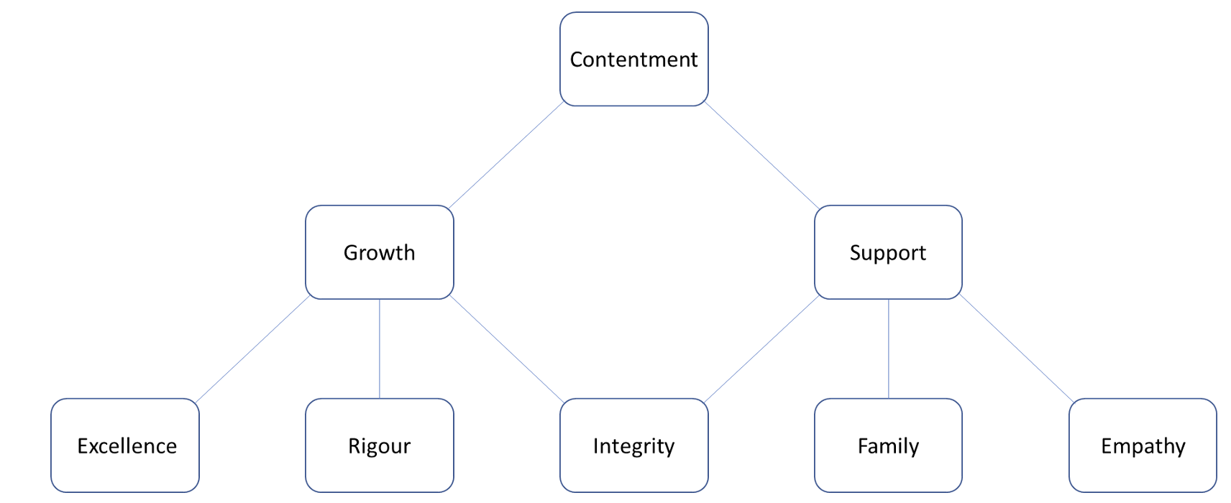
James Fifield

Slide 63
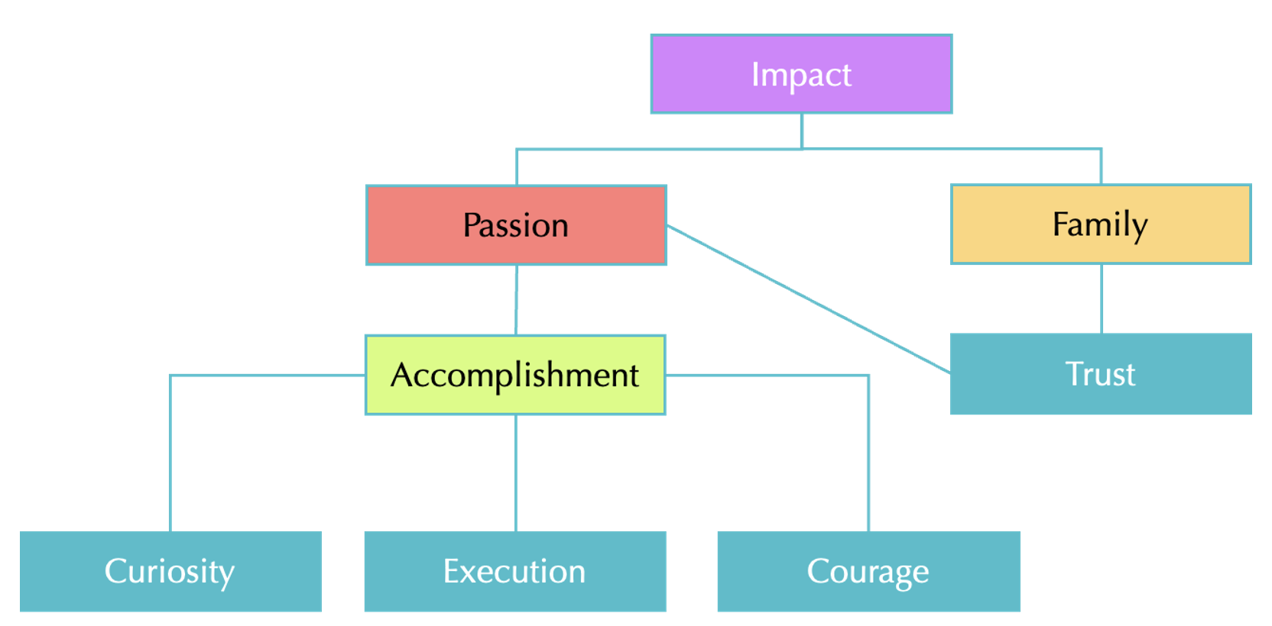
Daniela Hernandez

Slide 65
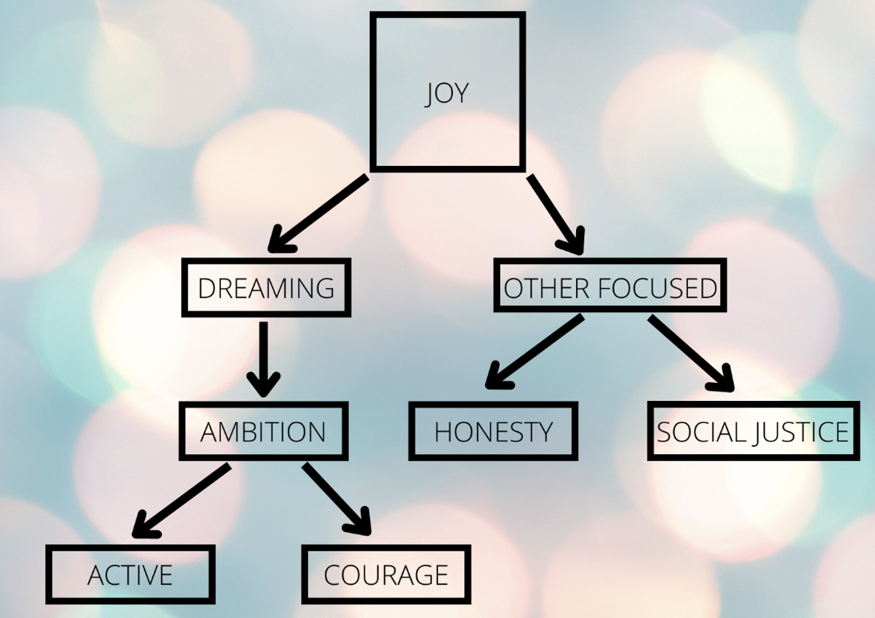
Dario Jimenez Mirayo

Slide 67
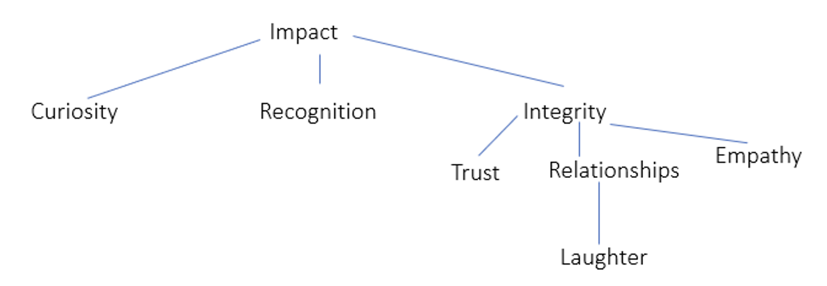
Shyra Khosla

Slide 69
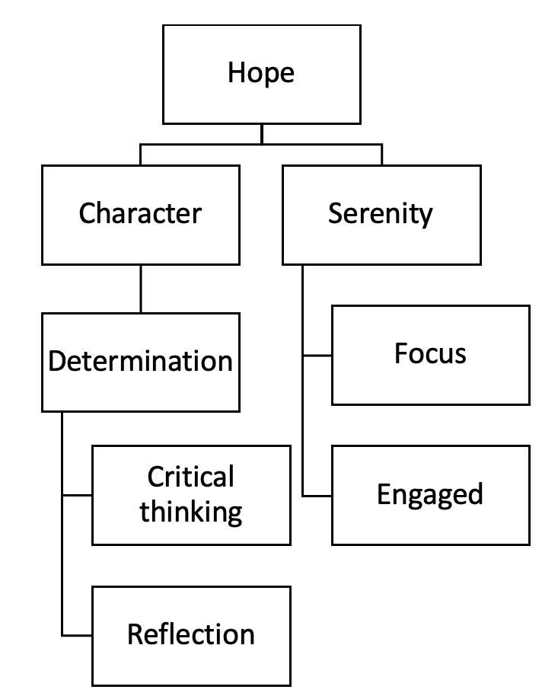
Wenjin Liu

Slide 71
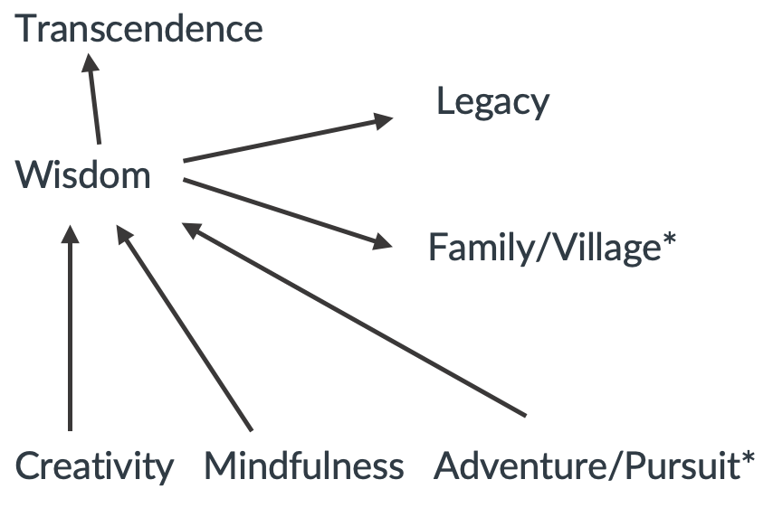
Stanislav Lopata

Slide 73
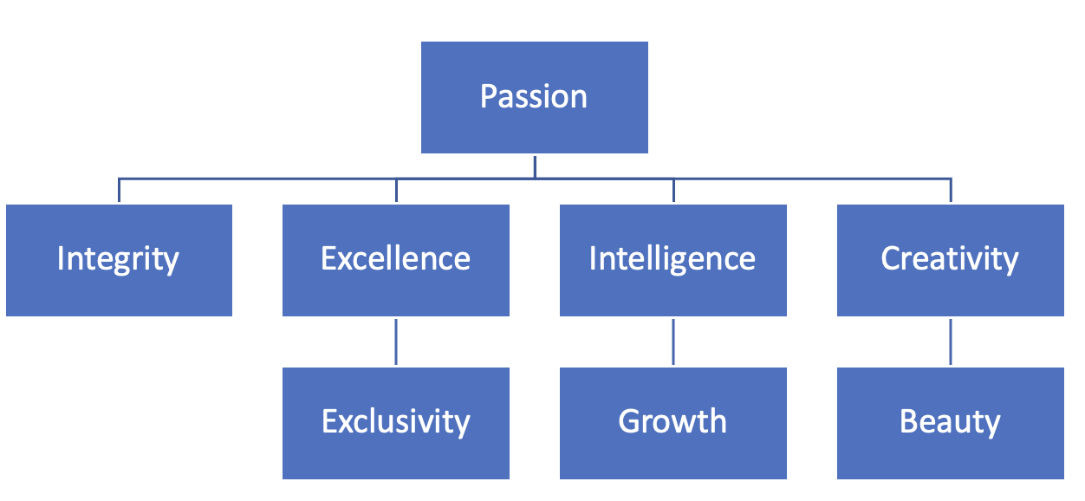
Alina Margarit

Slide 75
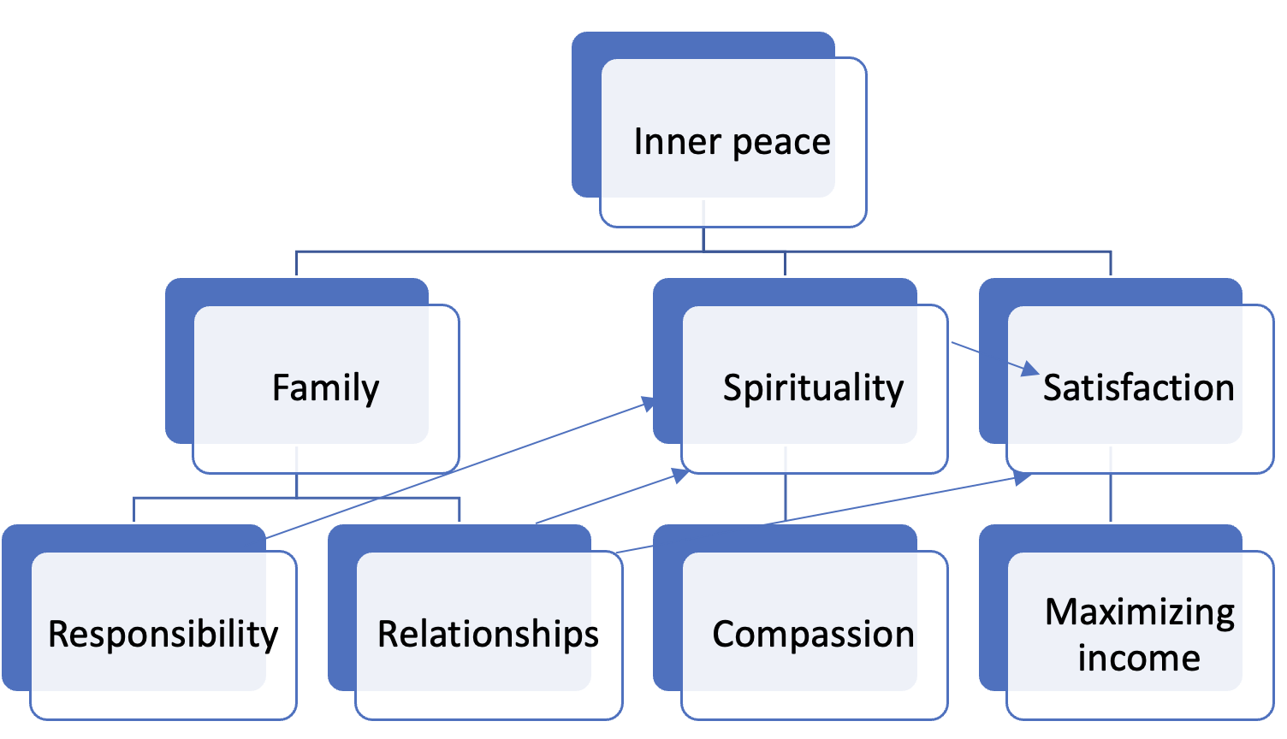
Sabir Niftaliyev

Slide 77
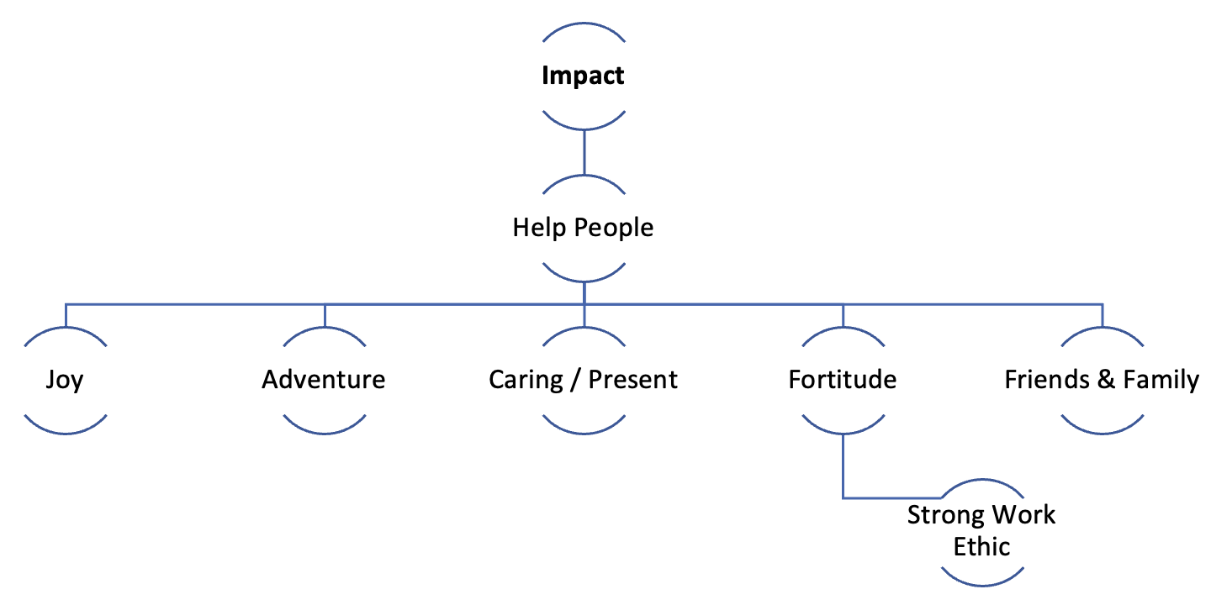
Patrick O'Neill

Slide 79
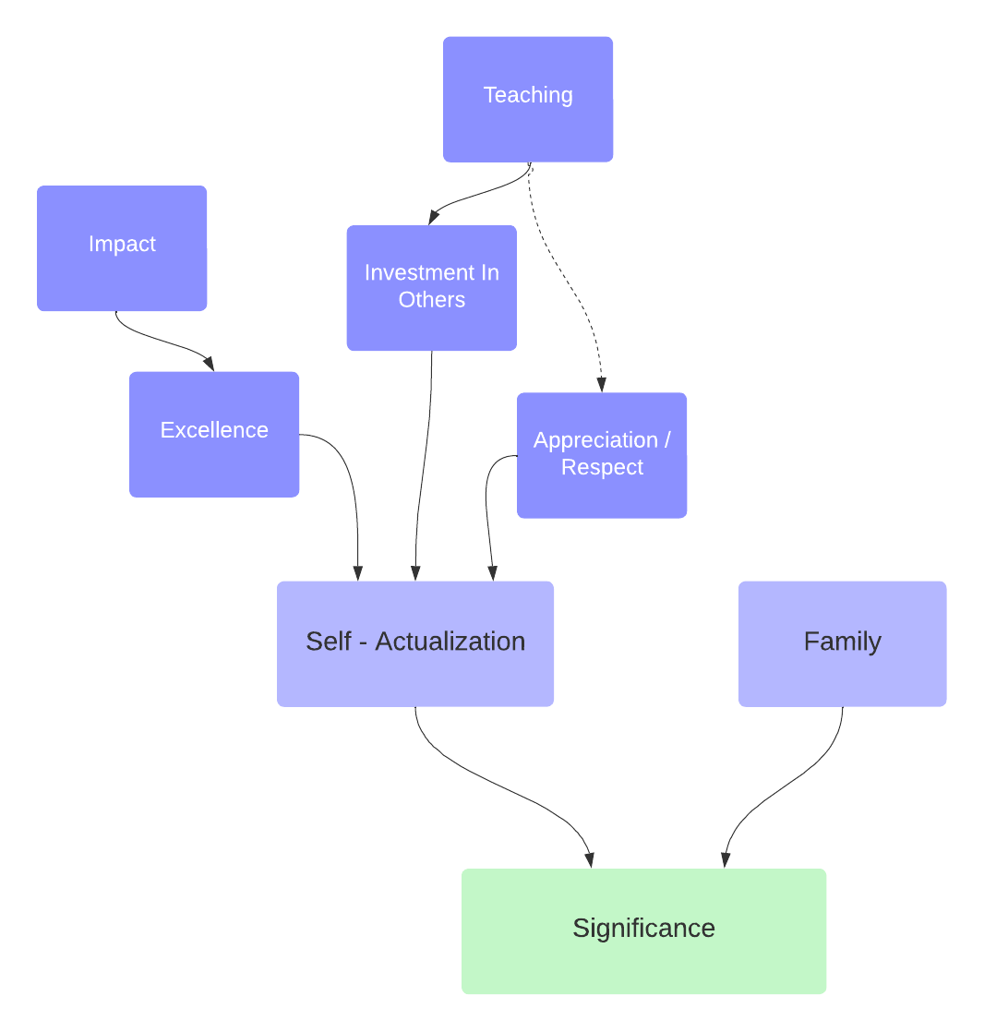
Elad Ophir

Slide 81
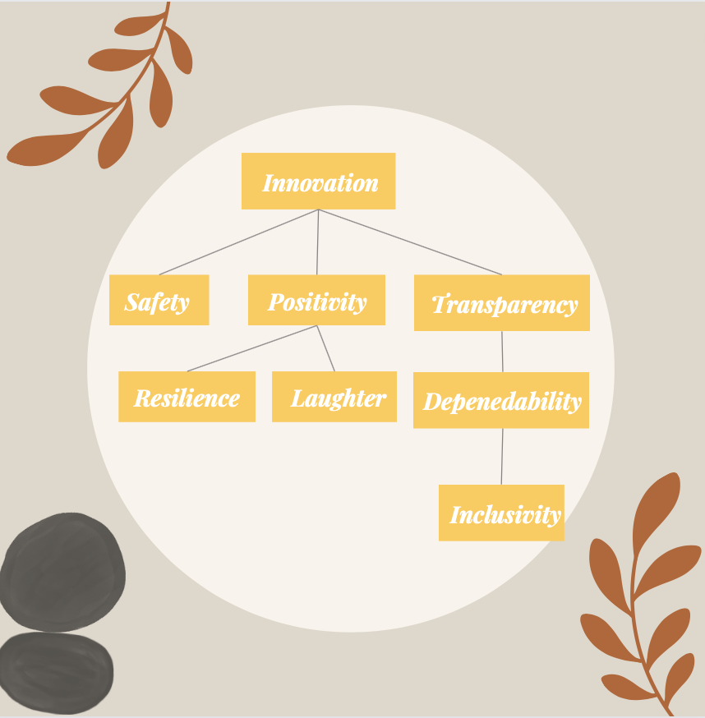
Bianca Parrish

Slide 83
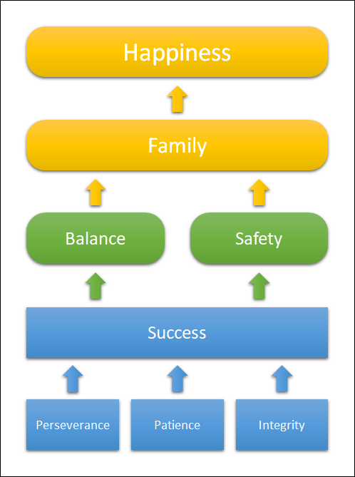
Michael Sherman

Slide 85
Oliver Singer
Harmony
Honour/
Self-Esteem
Discipline / Self- Improvement
Humility
Family & Friends
Humour
Determination
Kindness

Slide 87
Nicholas Stearns

Slide 89
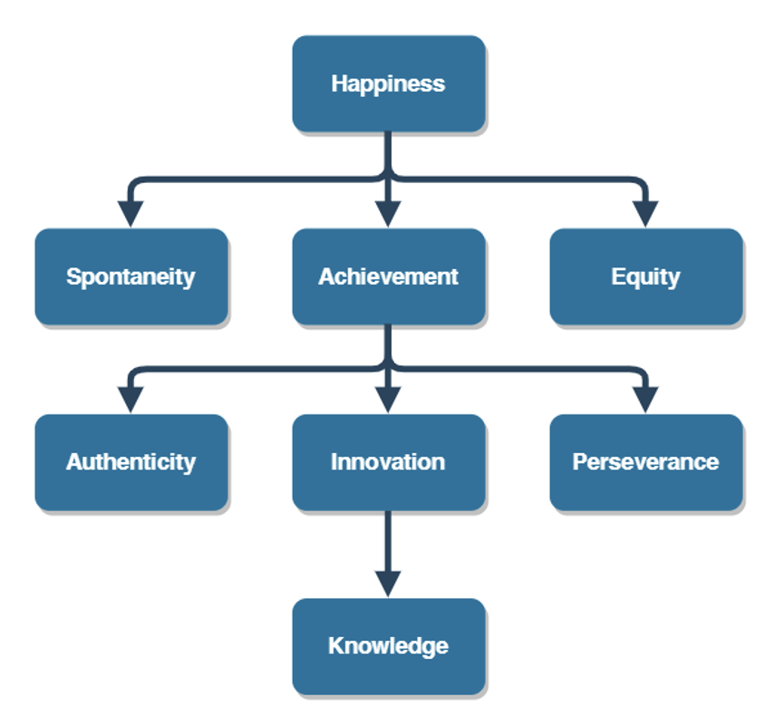
Robert Vogt IV

Slide 91
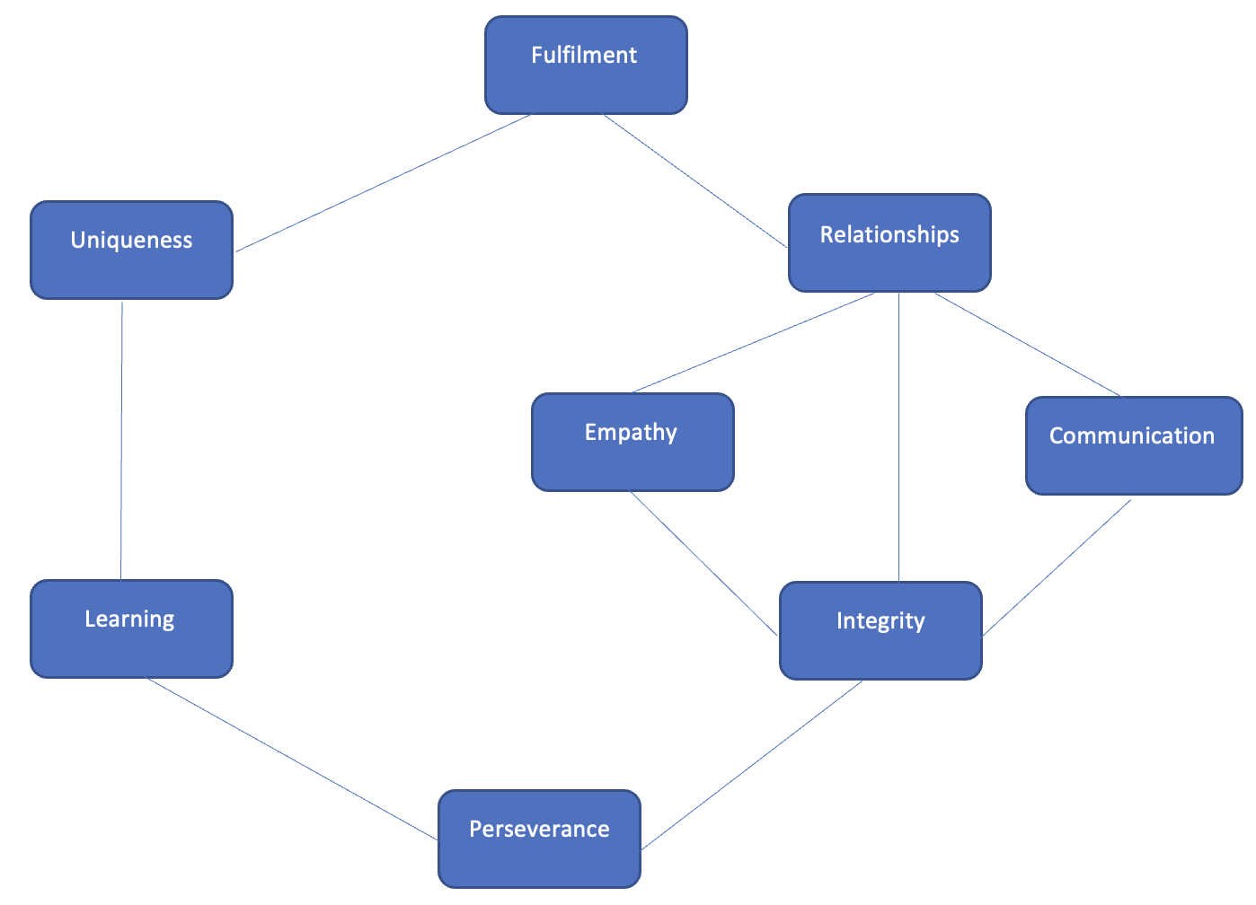
Fei-Fei Yang

Slide 93
Michael Sherman
Growth
Achievement
Family
Fairness
Loyalty
Smartness
Impact
Progress

Slide 95
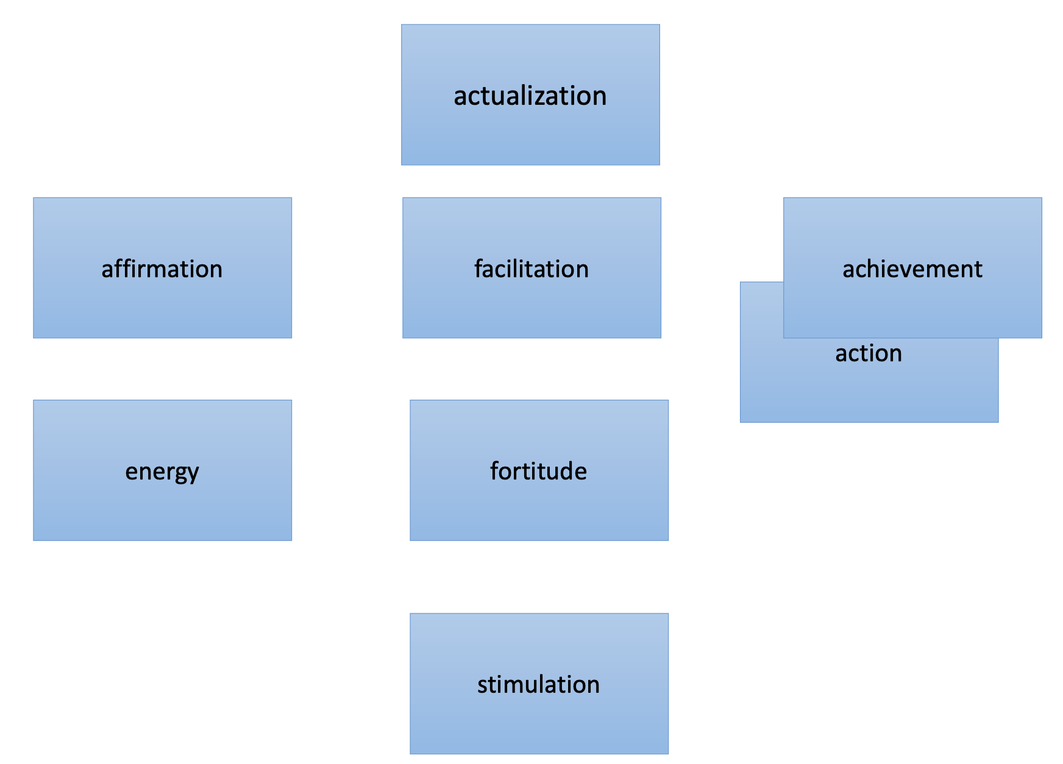
Egan Gunnarson

